Slide 1


Sustainable Agriculture with AI for Crop Yield Prediction
TEAM CODE : S4F_CP_Team_12234

Slide 2
Content
Abstract
Problem Statement
Objective
Data Collection and Preparation
Proposed Solution (Methodology)
Model Performance Evaluation
Screenshots / Demonstration (video)
Future Scope
Conclusion
Notes:
Abstract
Problem Statement (Clearly define the challenge)
Objective (State your project's goal)
Background and Research (Discuss existing solutions, trends, and gaps)
Data Collection and Preparation (Focus on data sources, cleaning, and augmentation)
Proposed Solution (Methodology)
Model Architecture (e.g., CNN, U-Net, YOLOv5)
Key Techniques (e.g., Transfer Learning, Image Augmentation)
Model Performance Evaluation
Metrics (Accuracy, Precision, Recall, IoU, etc.)
Graphs (Confusion Matrix, ROC Curve, etc.)
Screenshots / Demonstration (Visual proof of system functionality)
Future Scope (Improvements, scalability, and integration ideas)
Conclusion (Summarize results and impact)
Q&A Session

Slide 3
Abstract
Agriculture is highly influenced by environmental conditions like temperature, rainfall, and soil quality.
Climate change makes it crucial to predict crop yields accurately.
AI models can analyze historical data and environmental factors to optimize yield predictions.
This study explores how AI-driven models can assist farmers in making informed decisions.
The study highlights recent advancements, challenges, and future prospects of AI applications in sustainable agriculture.

Slide 4
Problem Statement
Challenges in Agriculture:
Dependence on unpredictable weather conditions
• Overuse of water and fertilizers
• Lack of precise yield forecasting
Solution:
AI-based models to predict crop yields and optimize resources.
Reduce resource wastage by applying inputs only where needed based on AI recommendations.

Slide 5
Objective
• Develop an AI model to predict crop yields based on environmental factors.
• Reduce resource wastage by providing actionable insights to farmers.
• Improve agricultural sustainability and productivity.
Implement AI solutions that reduce greenhouse gas emissions, soil degradation, and excessive chemical use, fostering eco-friendly agriculture.
Provide accessible AI tools and training to farmers, ensuring widespread adoption of smart agriculture practices for sustainable food production.

Slide 6
Data Collection and Preparation
Dataset: Crop yield data (5 years)
• Features:
- Crop Type
- Soil Quality Score
- Rainfall (mm/year)
- Temperature (°C)
• Target Variable: Yield (tons per hectare)
• Preprocessing:
- Handling categorical data (One-Hot Encoding)
- Normalization and scaling
- Splitting data for training and testing

Slide 7
Proposed Solution (Methodology)
Model Used: Support Vector Regression (SVR)
• Pipeline:
1. Data preprocessing using OneHotEncoder & StandardScaler
2. SVR model training with RBF kernel
3. Model evaluation using MSE and R² Score
• Benefits of SVR:
- Captures non-linear relationships in data
- Provides robust yield predictions

Slide 8
Model Performance Evaluation
Evaluation Metrics:
- Mean Squared Error (MSE): 1.25
- R² Score: 0.68
• Performance Analysis:
- The model shows moderate accuracy in predicting yields.
- Further improvements can be made with larger datasets.

Slide 9
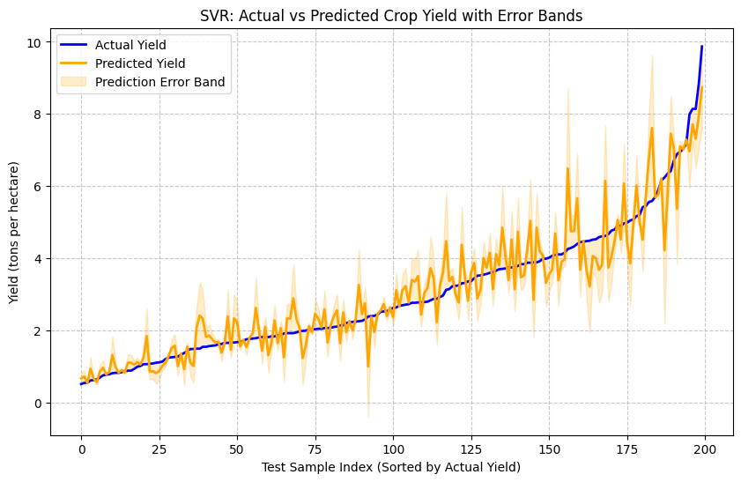
Screenshots

Slide 10
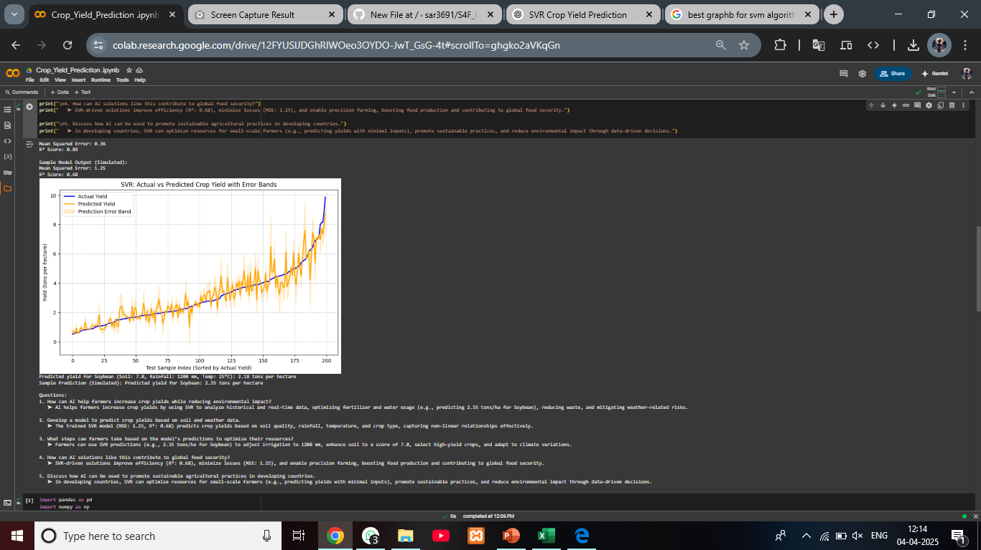
Screenshots
COLAB : https://colab.research.google.com/drive/12FYUSlJDGhRlWOeo3OYDO-JwT_GsG-4t#scrollTo=ghgko2aVKqGn
GITHUB : https://github.com/sar3691/S4F_CP_Team_12234

Slide 11
Future Scope
Enhancements:
- Incorporate satellite imagery for better soil analysis.
- Implement deep learning models for higher accuracy.
- Develop an AI-powered mobile application for real-time predictions
AI-Powered Precision Agriculture
Use of AI-driven automation to provide precision-based recommendations for seeding, fertilization, and harvesting.
Real-time detection and prevention of pest and disease outbreaks through AI-based image recognition.

Slide 12
Conclusion
• AI-based models can help farmers make data-driven decisions.
• Crop yield predictions enable better resource management.
• Adoption of AI in agriculture promotes sustainability and efficiency.
The integration of AI in agriculture fosters precision farming, improves supply chain efficiency, and empowers farmers with real-time insights.
However, challenges such as data accessibility, infrastructure limitations, and the need for farmer training must be addressed for widespread adoption.

